Slide 1
PLAIN TEXT = HELLO KEY = MONARCHY USING PLAYFAIR CIPHER
M | O | N | A | R
C | H | Y | B | D
E | F | G | I/J | K
L | P | Q | S | T
U | V | W | X | Z
CIPHER TEXT: CF SU PM

Slide 2
USING CAESAR CIPHER ENCRYPT & Decryption PLAIN TEXT = FIRSTTIME KEY = 4
C = ( P + K ) MOD N
P = ( C – K ) MOD N
CIPHER TEXT = JMVWXXMQI

Slide 3
USING Affine CIPHER ENCRYPT & DECRYPT PLAIN TEXT = WORLOST KEY = 10 m = 9
C = m* P + K MOD N
P = m^-1*( C – K ) MOD N
CIPHER TEXT = AKHFGQZ

Slide 4
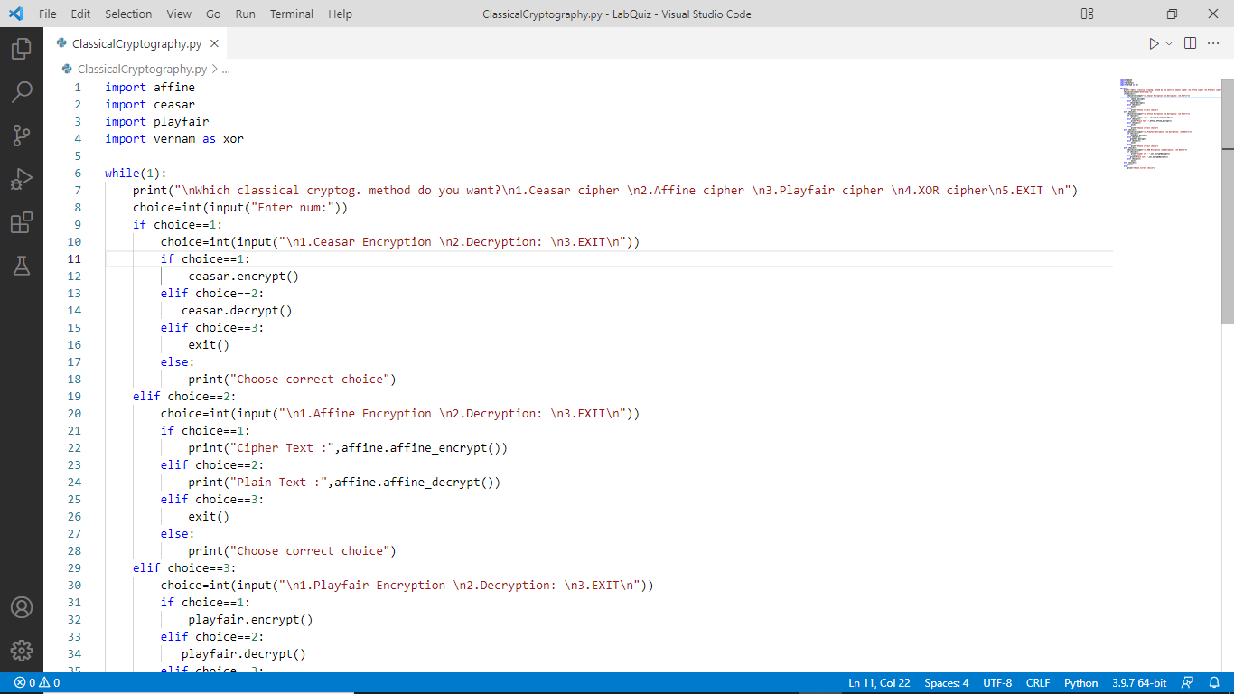
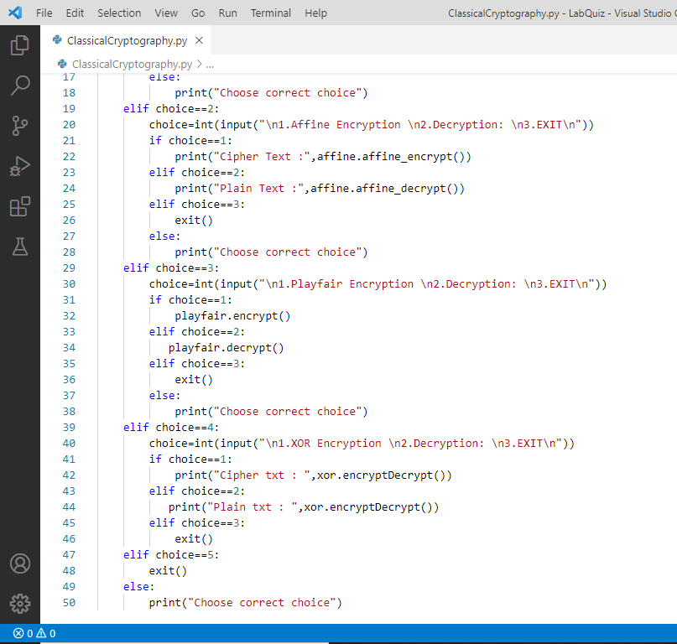

Slide 5
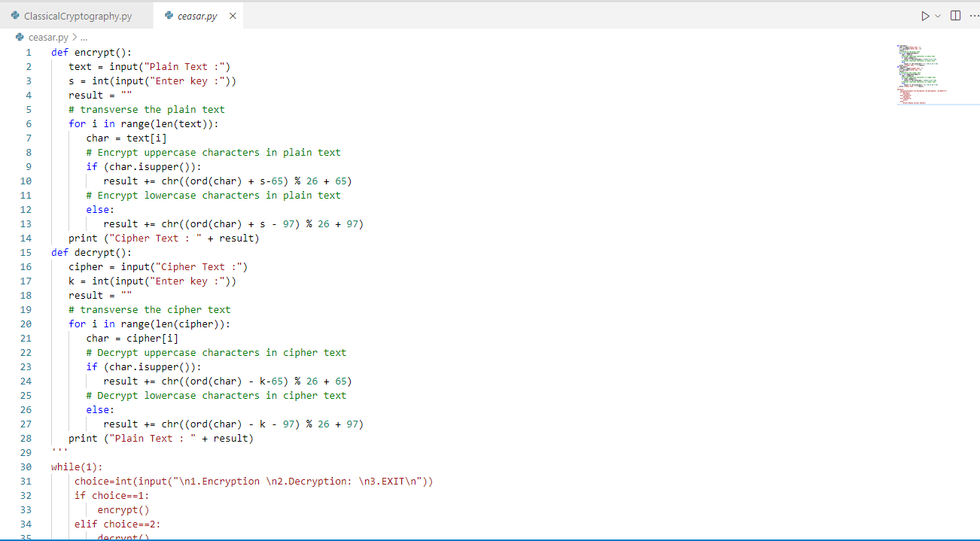

Slide 6
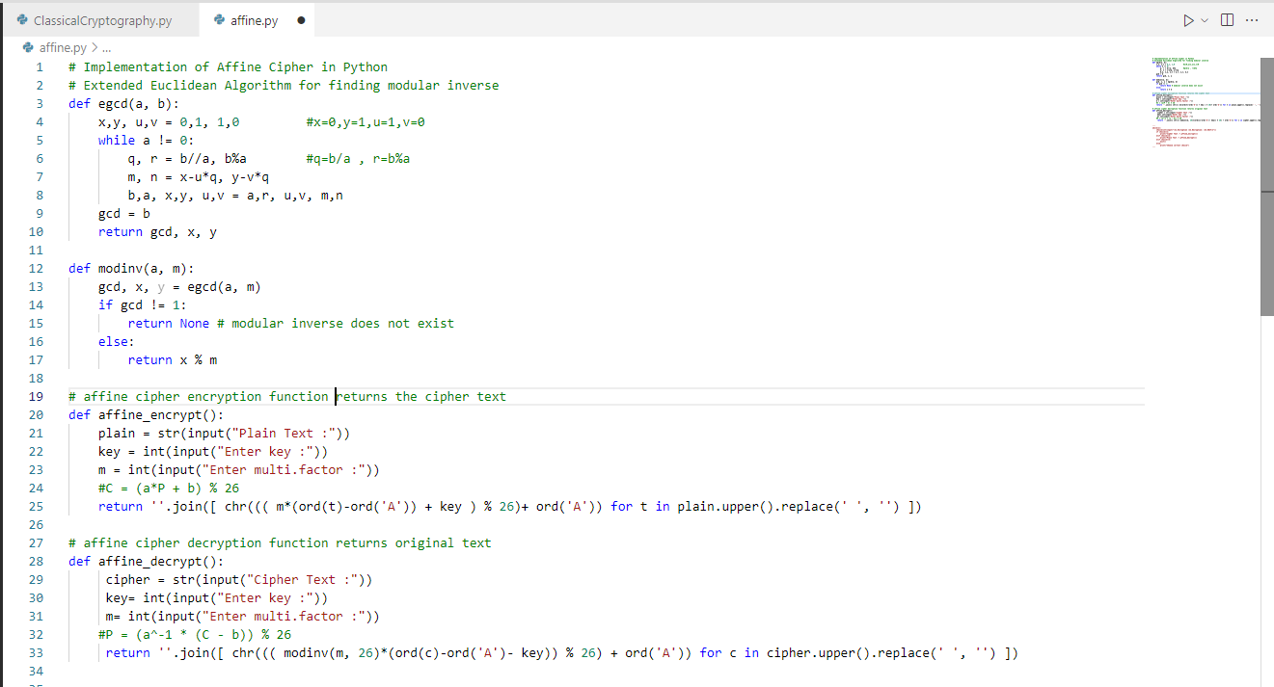

Slide 7
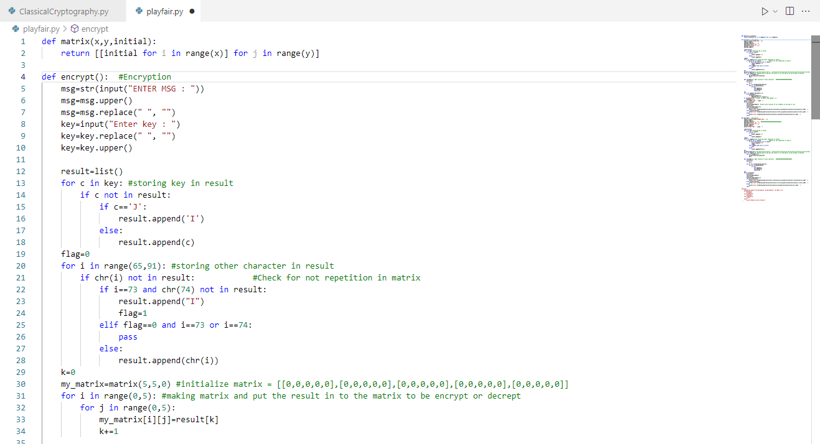
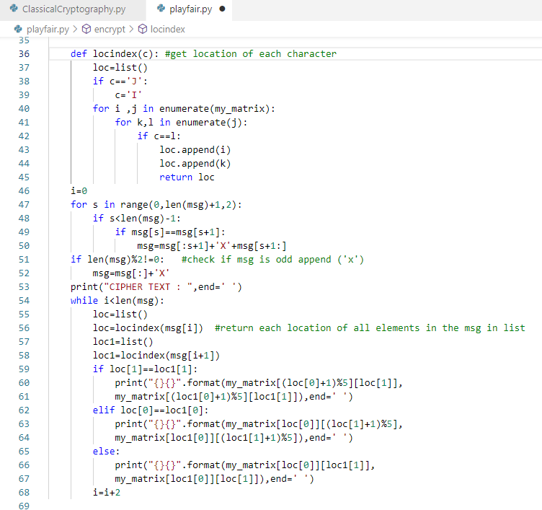

Slide 8
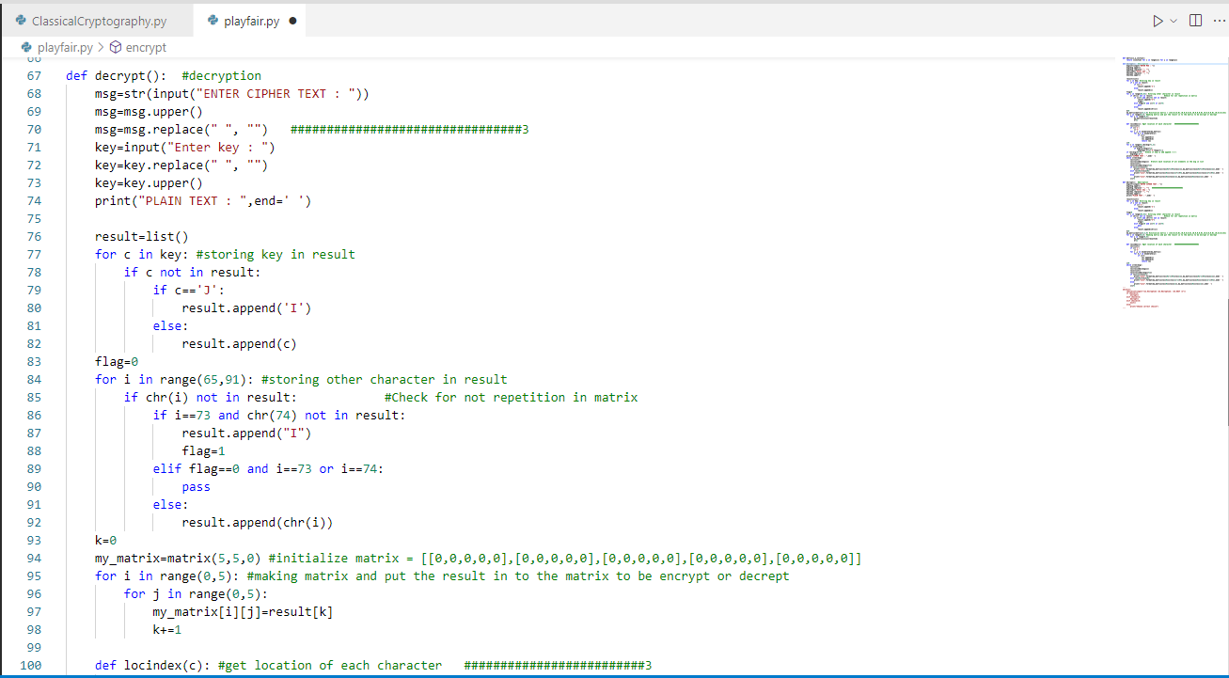

Slide 9
